Slide 1
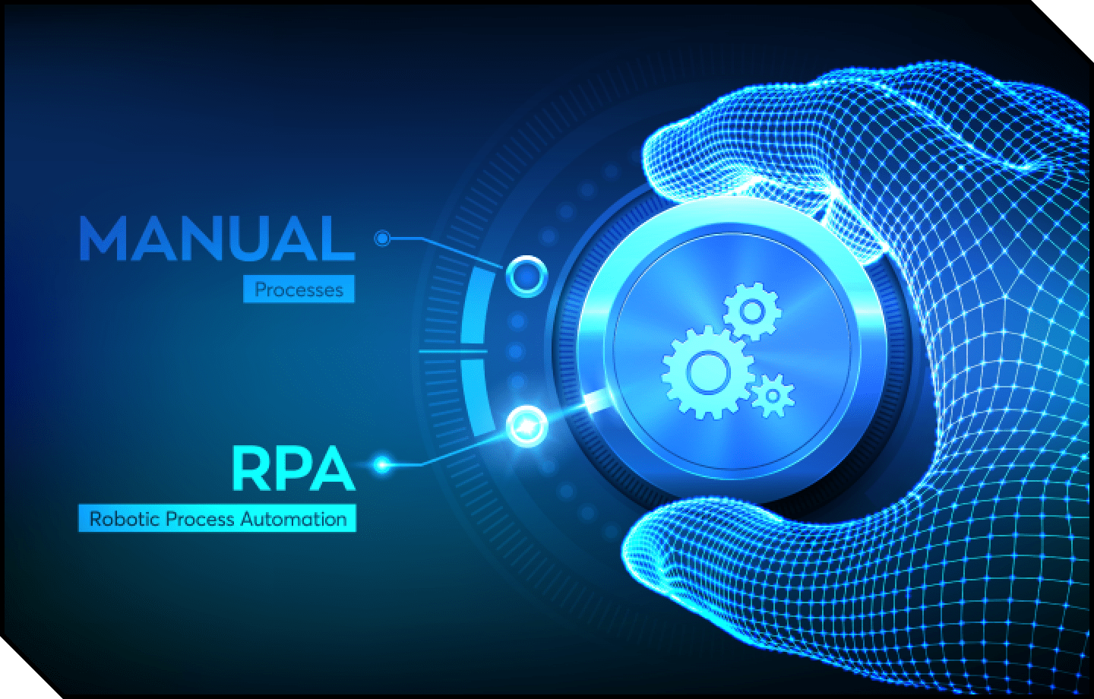

RPA(Robotics Process Automation)
With
Automation Anywhere

Slide 2
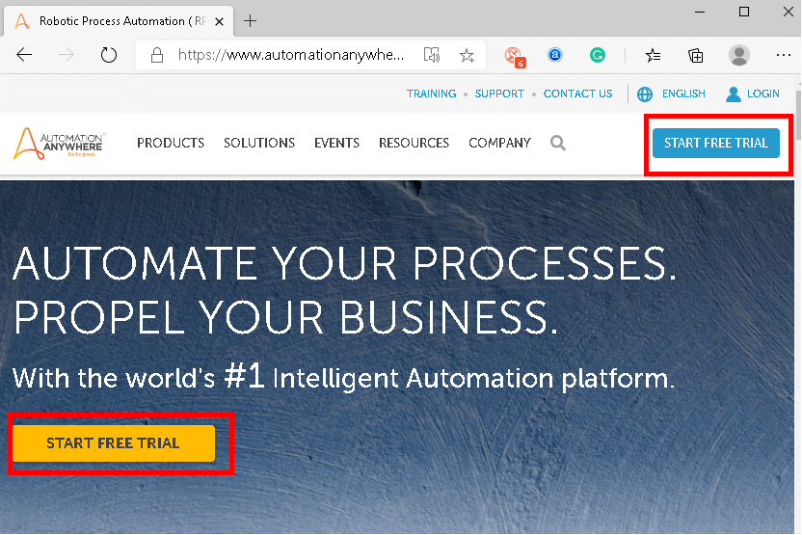
Register for the Automation Anywhere Community Edition:
Step 1: First, we need to navigate to the official site here: https://www.automationanywhere.com/
Step 2: Then, we need to click on the "Start Free Trial" button, as shown in the following image:

Slide 3
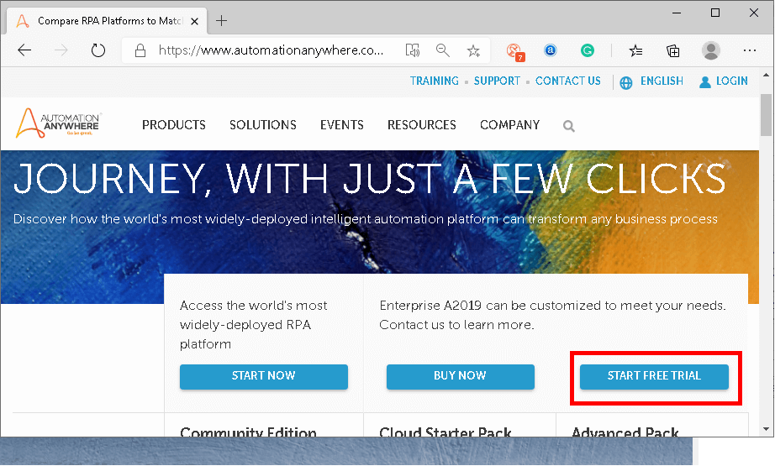
Step 3: On the next screen, we will see different versions of Automation Anywhere and their features. Again, we need to click on a button "Start Free Trial".

Slide 4
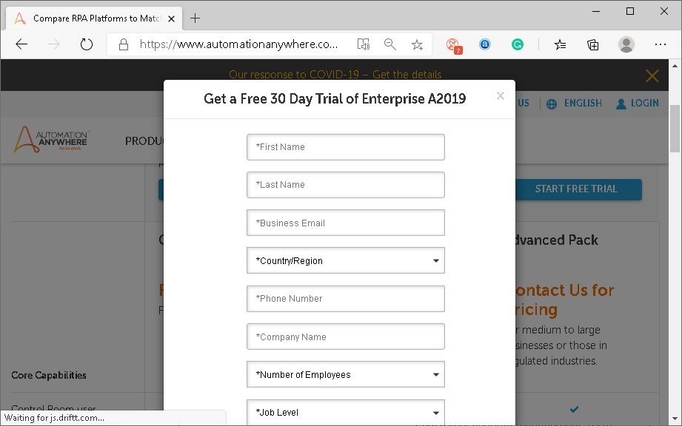
Step 4: On the next screen, we will see a form asking several details from our side. We need to fill all the details and submit the form to get the trial of Automation Anywhere.

Slide 5
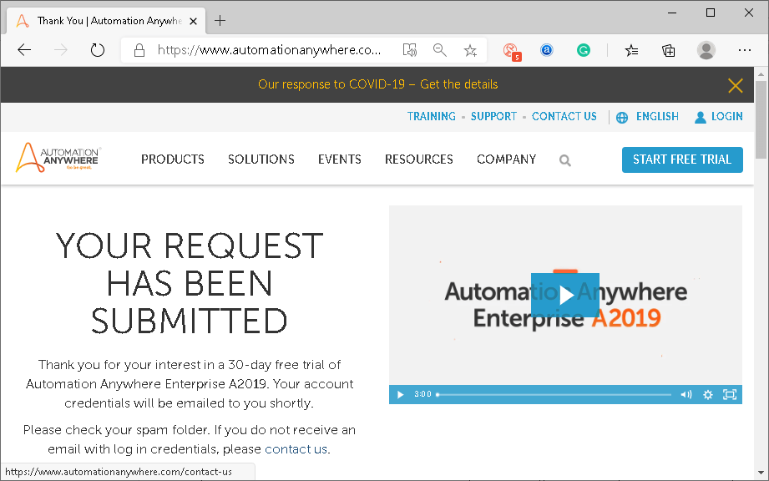
Once we submit the form, we receive the confirmation of the submission, as shown below:

Slide 6
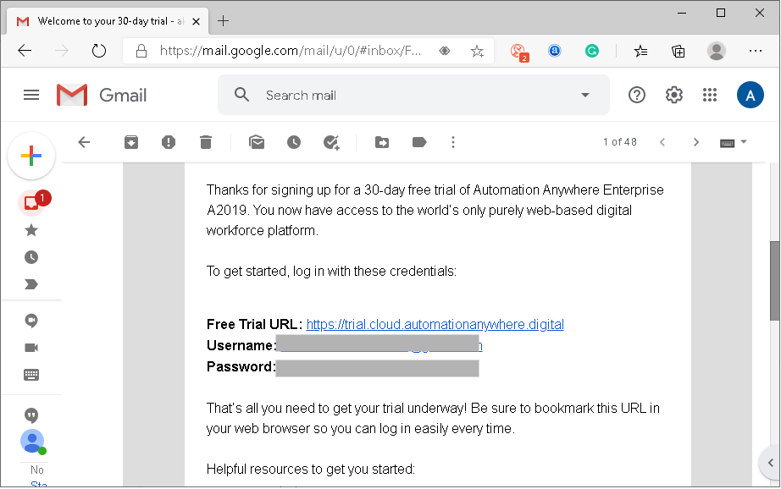
The login details and a link are sent over the mail that we used while filling up the form.

Slide 7
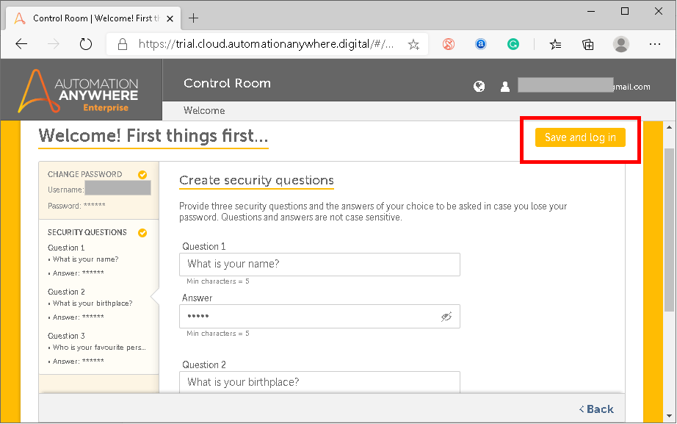
Step 5: Next, we are required to open a link and sign-in with the credential given in the email. As soon as we log in, we get a screen asking us to set a new password rather than using the default one sent over mail.
Also, we need to set up some security questions required to recover our account if we forget the login credentials.

Slide 8
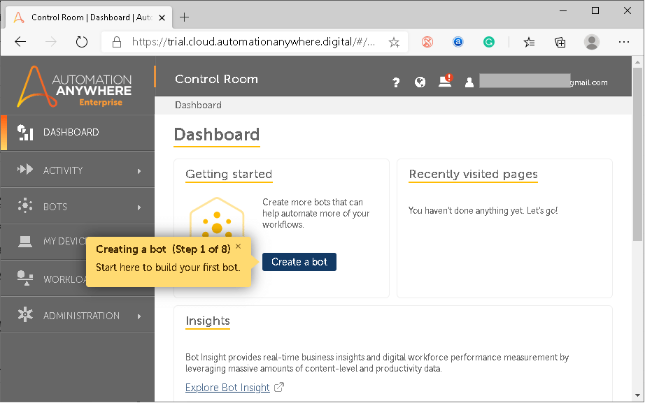
Once we have configured all these steps, we will get to the Control Room (dashboard) of Automation Anywhere.

Slide 9
Step 6: At last, we need to connect our local machine by following on-screen instructions and installing some packages to implement IQ Bots into our machine.
That is how we can install Automation Anywhere.

Slide 10
Interfacing with Automation Anywhere

Slide 11
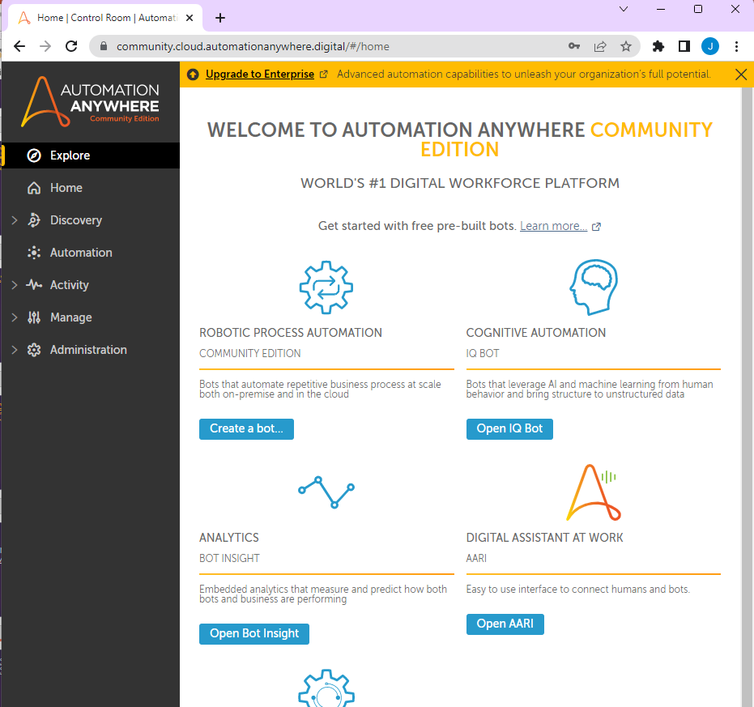
Go to mail which send by Automation anywhere
Note down your password And User ID
Click on Link of Automation anywhere
that us open in New Tab
Log in
You can also go to this site :-
https://community.cloud.automationanywhere.digital/#/home

Slide 12
For your first Bot
____________
Click on Create tour Bot
2. Your first bot is open
3. Your Bot ready for programming

